Slide 1
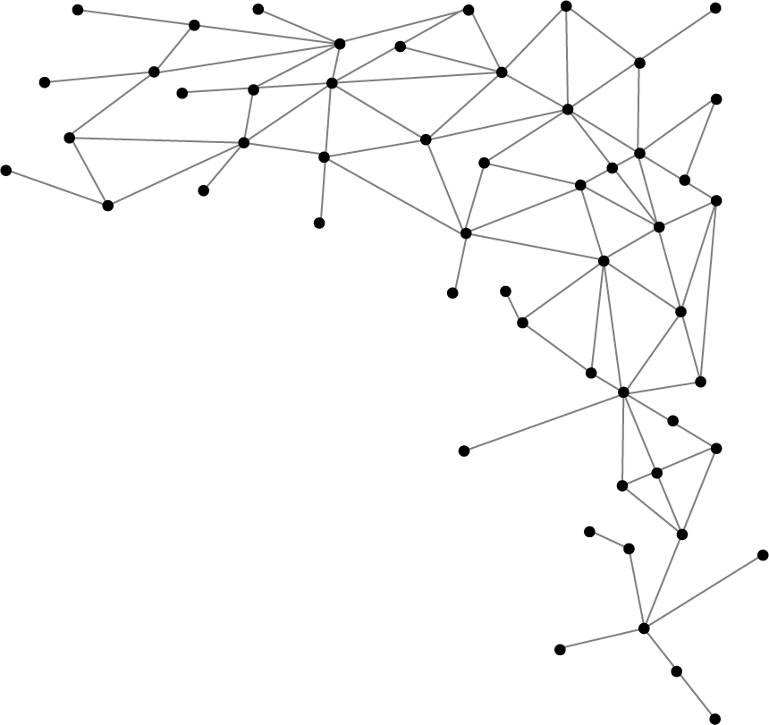




Machine Learning
I am Saif Hassan
Lecturer (CS@SIBAU)
@saifhassandr
@saifhassandr

Slide 2
Agenda
Supervised/Unsupervised with Example
Learning → Three Core Components

Slide 3
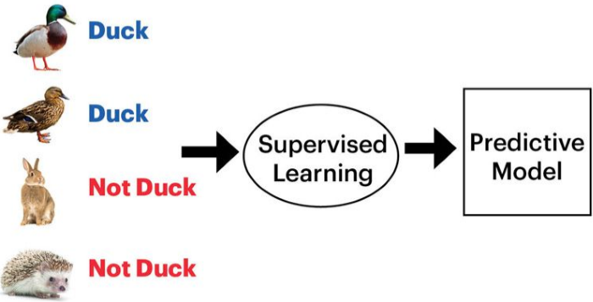
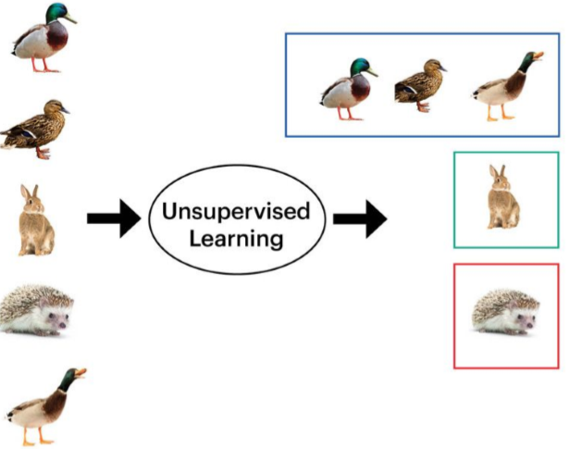

Example

Slide 4
Supervised/Unsupervised
Supervised Learning
Human assigns label to each input image
Algorithm learns to predict the label
Unsupervised Learning
No labels are assigned
Discover group based on similarities

Slide 5
Learning → Three Core Components
Representation
Evaluation
What model you choose?
A linear function?
A decision tree?
A neural network?
Optimization

Slide 6
Learning → Three Core Components
Representation
How do we differentiate good models from bad ones?
# of errors on some test set?
Precision/Recall?
Mean Squared Error?
Likelihood?
Evaluation
Optimization

Slide 7
Learning → Three Core Components
Representation
Evaluation
What is our process for finding the good models among all the possible models?
Gradient Descent?
Greedy Search?
Optimization

Slide 8
THANKS!
@saifhassandr
Any questions?
Leave comments below.

